Slide 1

Advances in intelligent systems and robotics – part 1
Chua Boon Rong Adriel A0179692J
Gao Wenqi A0146665W
Project Group 2 (Friday Session)

Slide 2

PROBLEM STATEMENT
TurtleBot needs to navigate in an unknown map of size 9 x 9 sq.m.
The starting and ending points are known.

Slide 3
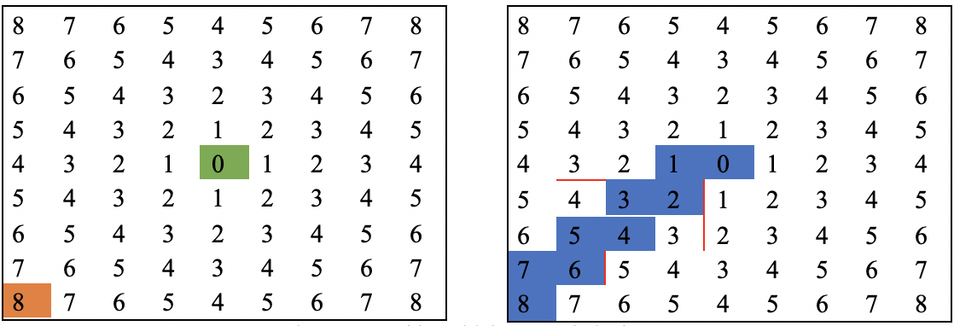
Flood Fill Algorithm
This algorithm works by discovering walls and obtaining the best available route to the goal.
The mechanism starts from the final point by giving it an initial value and then moves forward to other neighbouring points by giving them higher values.

Slide 4
SOLUTION FRAMEWORK
Global Planning
Mapping
Localisation
Path planning
Determine start and goal positions
Plan most cost efficient path
Local Planning
Obstacle Avoidance
Update Map
Motion Control
Choosing velocities needed to reach set points
Position feedback loop

Slide 5
Sub-systems and algorithms
Nodes
Path Planner
Flood Fill Algorithms
Range Finder
Laserscan
Navigator
Motion Controller
Camera Operations
RGB Camera

Slide 6
PERFORMANCE ANALYSIS – World 1
Time Taken: Average 40s
Route Taken: Direct route
Failures: 1 failure from a series of runs, due to TurtleBot hitting the wall when moving forward near goal point, giving a false goal reached status.

Slide 7
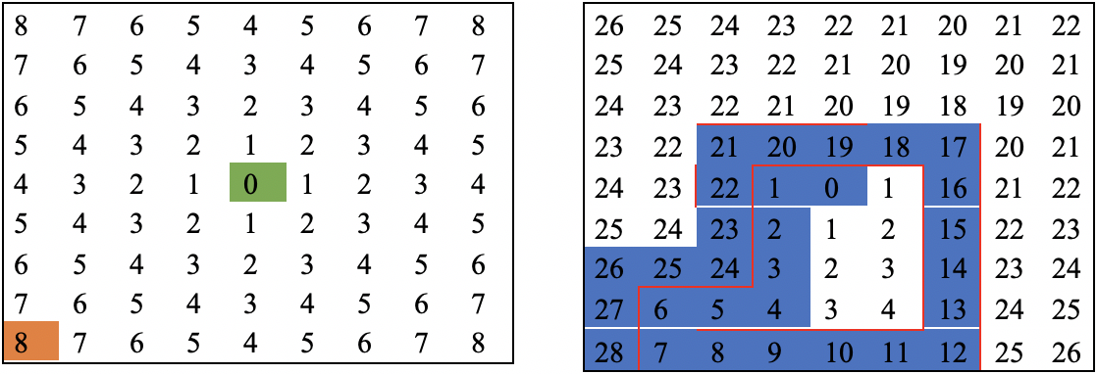
PERFORMANCE ANALYSIS – World 2
Time Taken: Average 160s
Route Taken: Indirect route
Failures: None
Reason for indirect route: Flood Fill cost cell for 2 adjacent cells have the same value.

Slide 8
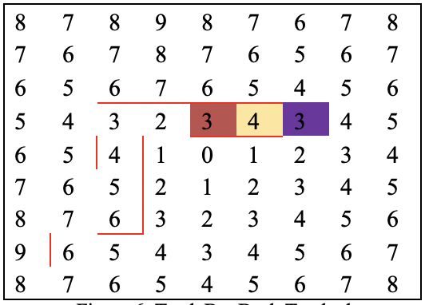
PERFORMANCE ANALYSIS – World 2
TurtleBot turned back at the cost cell 4 (highlighted in yellow) to head back to red colored cost cell 3.
Manhattan distance for the red cell 3 was lower than the purple cell.
TurtleBot also did not capture the wall adjacent of the red cost cell 3.
TurtleBot sensed the wall with the Laserscan sensor, and updated the flood fill map to correctly identify the cost values and turned back towards the correct heading.

Slide 9
DEMONSTRATION
Demonstration will be performed on Test World 2
The navigation package can be found on GitHub
https://github.com/gaowq1994/ee4308_project_adriel_wenqi

Slide 10
CONCLUSION
Observations:
The flood fill algorithm allows the TurtleBot to perform autonomous path planning.
One limitation of the flood fill algorithm is that the speed is dependent on map size.
Instances whereby TurtleBot will backtrack due to cells adjacent to the current cells having the same cost value.
Limitations and Potential Improvements
Changing algorithm to Dijkstra’s Algorithm with multilayer dictionary to allow for path planning to consider length and difficulty of the path.
In World 2, the TurtleBot backtracked and to alleviate this we can make the TurtleBot turn 90 degrees clockwise to scan for walls after each turn.
Applications
RGB Camera window can provide the command centre with a real-time view of environment the TurtleBot is in.

